Slide 1
ARP Spoofing

Slide 2
Introduction
A computer connected to an IP/Ethernet has two addresses
  Address of network card (MAC address)
    Globally unique and unchangeable address stored on the network card.
    Ethernet header contains the MAC address of the source and the destination computer.
  IP address
    Each computer on a network must have a unique IP address to communicate.
    Virtual and assigned by software.

Slide 3
IP communicates by constructing packets.
Packet are delivered by Ethernet.
  Adds an Ethernet header for delivery
  Splits the packets into frames
  Sends them down the cable to the switch.
  The switch then decides which port to send the frame to. By comparing the destination address of the frame to an internal table which maps port numbers to MAC addresses.

Slide 4
When an Ethernet frame is constructed from an IP packet, it has no idea what the MAC address of the destination machine is.
The only information available is the destination IP address.
There must be a way to the Ethernet protocol to find the MAC address of the destination machine, given a destination IP.
This is where ARP, Address Resolution Protocol, come in.

Slide 5
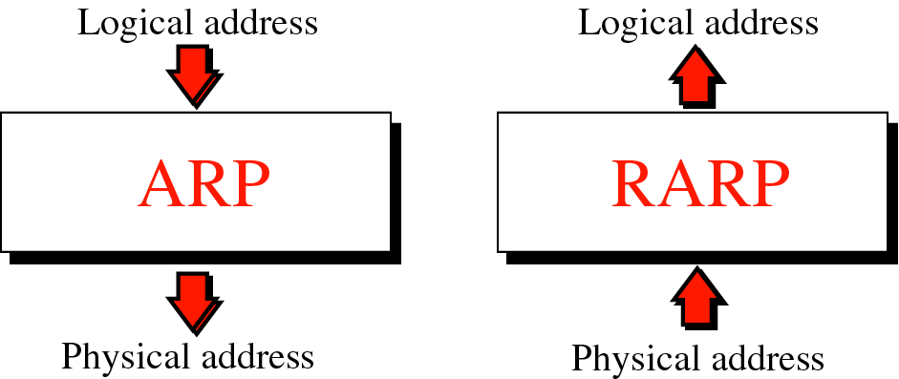
Figure 8-1
Address resolution and Reverse address resolution

Slide 6
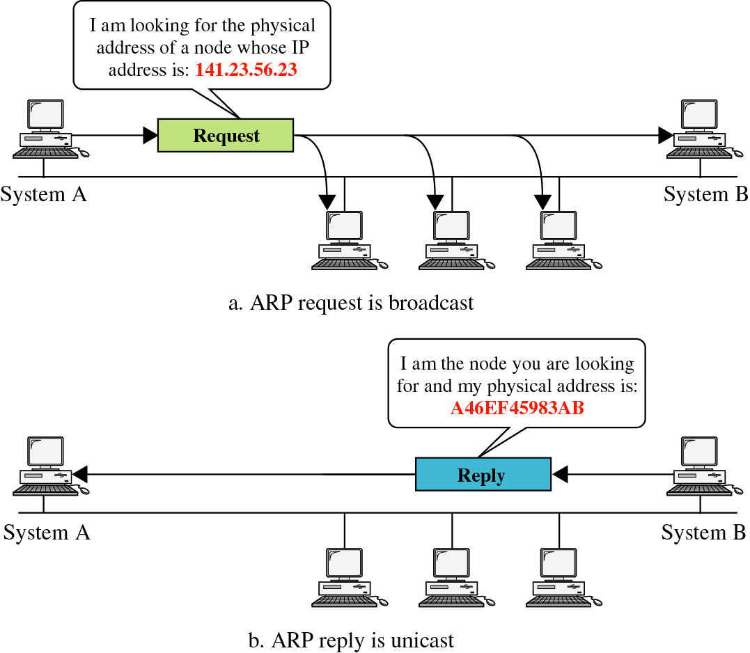
Figure 8-2

Slide 7
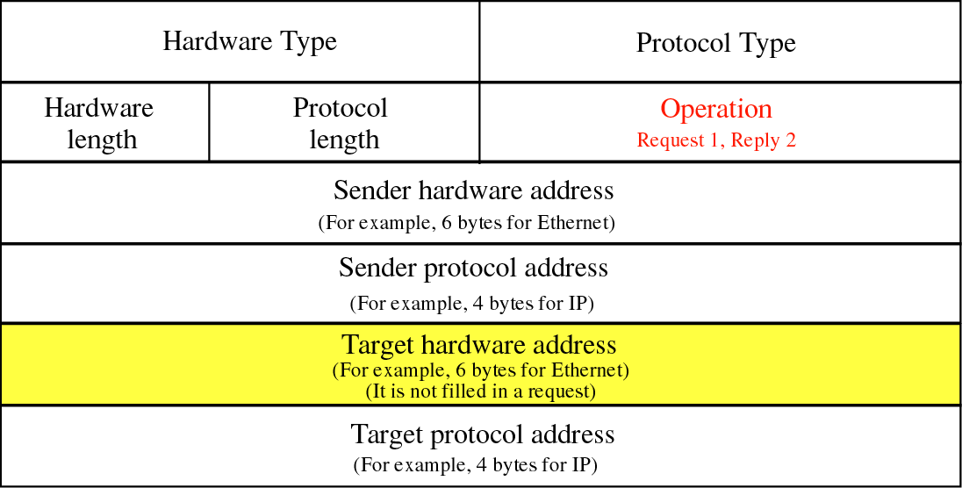
Figure 8-3

Slide 8
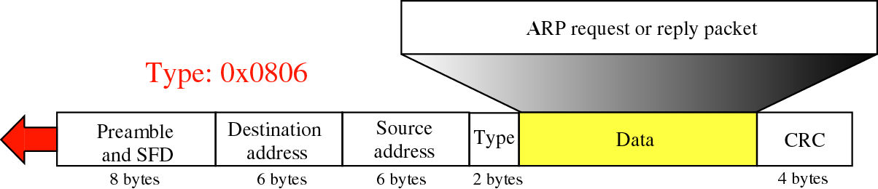

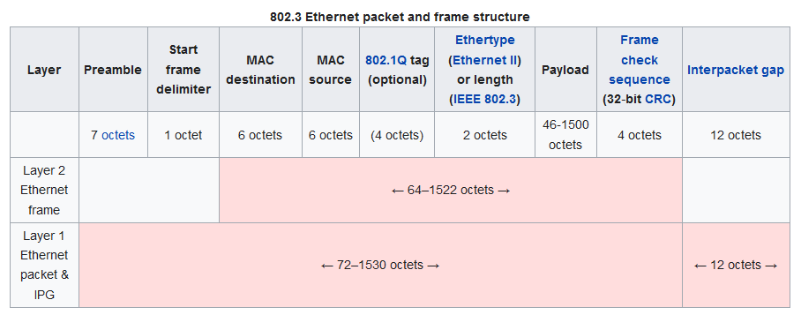
Figure 8-4
Encapsulation of ARP
Notes:
The preamble consists of a 56-bit (seven-byte) pattern of alternating 1 and 0 bits, allowing devices on the network to easily synchronize their receiver clocks, providing bit-level synchronization.
It is followed by the SFD to provide byte-level synchronization and to mark a new incoming frame.
https://www.geeksforgeeks.org/ethernet-frame-format/

Slide 9
How ARP functions:
  Get IP address of target.
  Create a request ARP message
    Fill sender physical address
    Fill sender IP address
    Fill target IP address
    Target physical address is filled with 0
  The message is passed to the data link layer where it is encapsulated in a frame.
    Source address: physical address of the sender.
    Destination address: broadcast address.

Slide 10
  Every host or router on the LAN receives the frame.
    All stations pass it to ARP.
    All machines except the one targeted drop the packet.
  The target machine replies with an ARP message that contains its physical address.
    A unicast message.
  The sender receives the reply message and knows the physical address of the target machine.

Slide 11
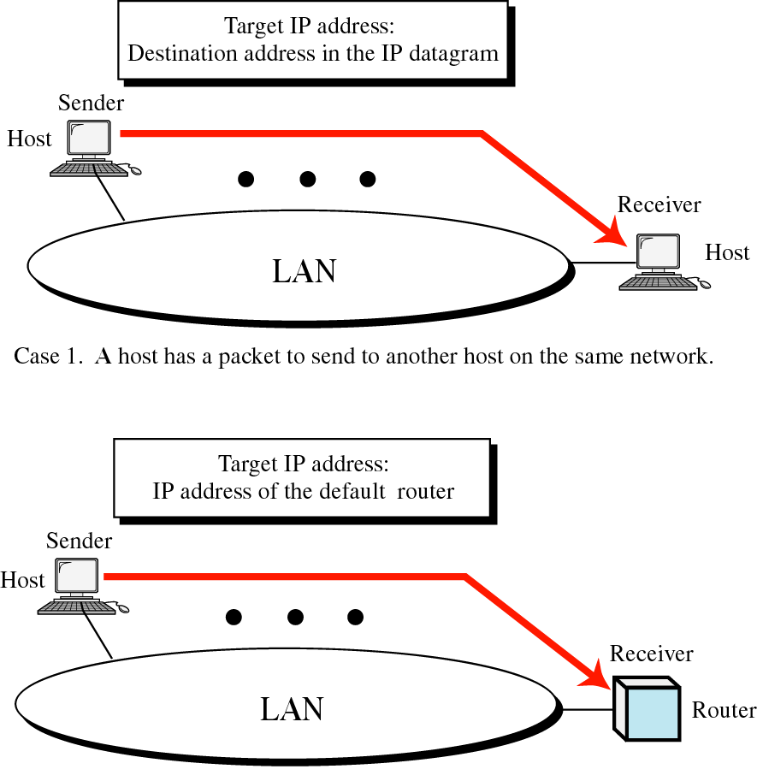
Figure 8-5, Part I

Slide 12
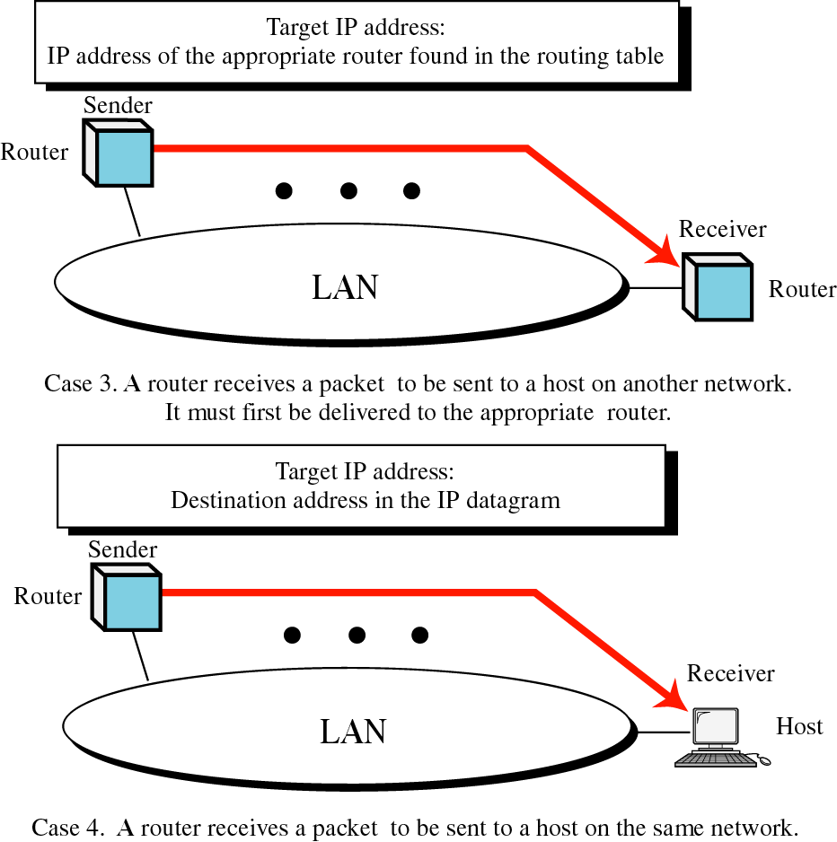
Figure 8-5, Part II

Slide 13
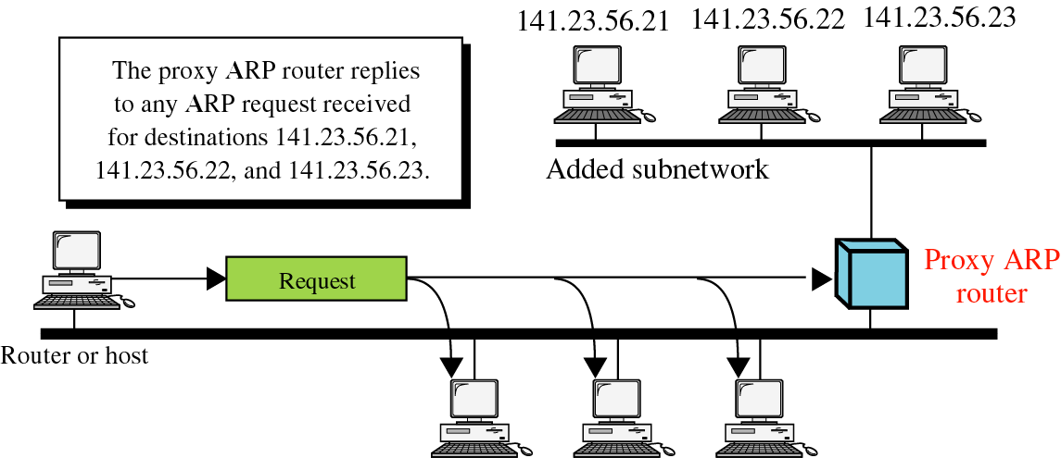
Figure 8-6

Slide 14
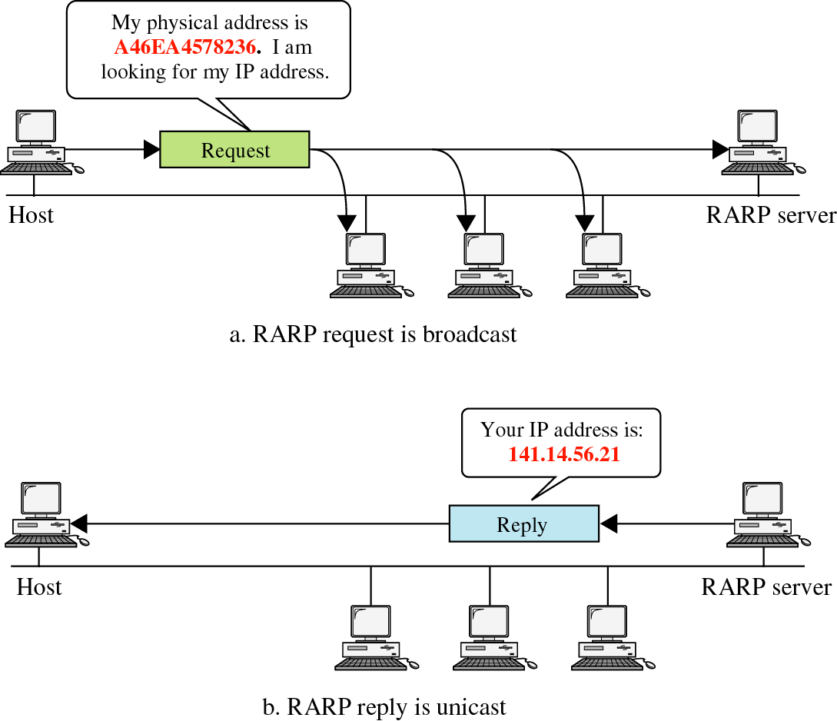
Figure 8-8

Slide 15
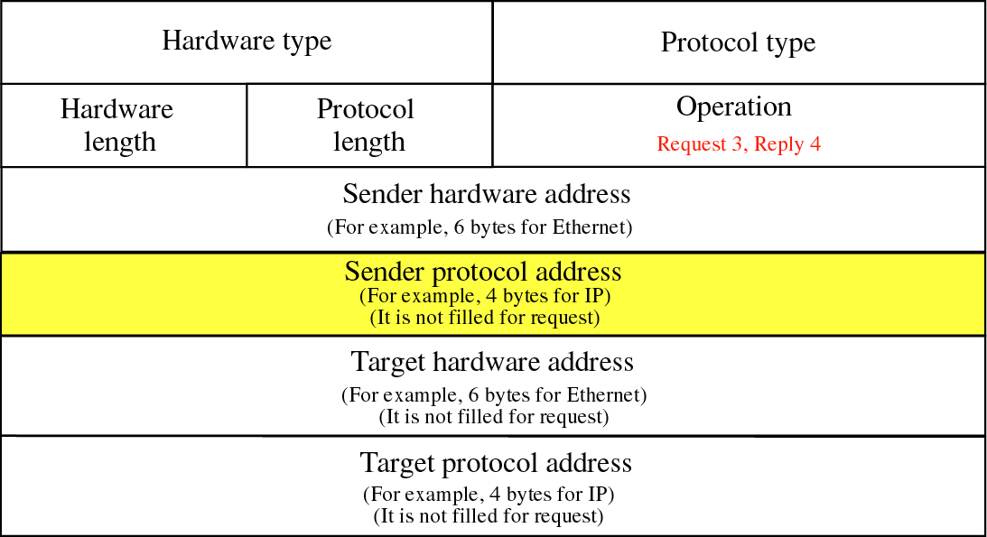
Figure 8-9

Slide 16
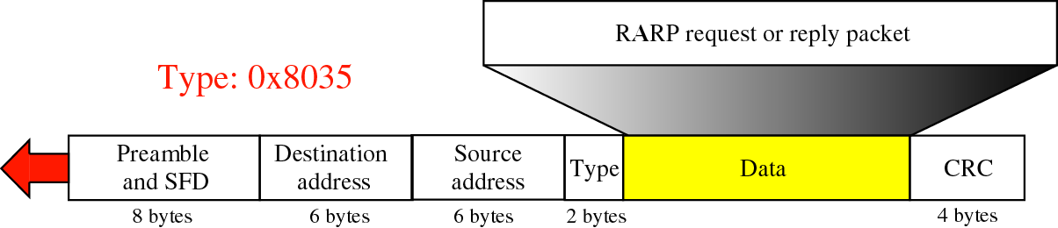
Figure 8-10

Slide 17
  To avoid having to send an ARP request packet each time, a host can cache the IP and the corresponding host addresses in its ARP table (ARP cache).
  Each entry in the ARP table is usually “aged” so that the contents are erased if no activity occurs within a certain period.
  When a computer receives an ARP reply, it will update its ARP cache.
  ARP is a stateless protocol, most operating systems will update their cache if a reply is received, regardless of whether they have sent out an actual request.

Slide 18
ARP Spoofing
Construct spoofed ARP replies.
A target computer could be convinced to send frames destined for computer A to instead go to computer B.
Computer A will have no idea that this redirection took place.
This process of updating a target computer’s ARP cache is referred to as “ARP poisoning”.

Slide 19
Spoofed ARP reply
IP:10.0.0.2
MAC:cc:cc:cc:cc
Spoofed ARP reply
IP:10.0.0.2
MAC:cc:cc:cc:cc
switch
Spoofed ARP reply
IP:10.0.0.2
MAC:cc:cc:cc:cc
A
IP:10.0.0.1
MAC:aa:aa:aa:aa
B
IP:10.0.0.2
MAC:bb:bb:bb:bb
Hacker
IP:10.0.0.3
MAC:cc:cc:cc:cc
ARP cache
ARP cache
IP | MAC
10.0.0.2 | bb:bb:bb:bb
IP | MAC
10.0.0.1 | aa:aa:aa:aa

Slide 20
switch
A
IP:10.0.0.1
MAC:aa:aa:aa:aa
B
IP:10.0.0.2
MAC:bb:bb:bb:bb
Hacker
IP:10.0.0.3
MAC:cc:cc:cc:cc
ARP cache
ARP cache
IP | MAC
10.0.0.2 | cc:cc:cc:cc
IP | MAC
10.0.0.1 | aa:aa:aa:aa
A’s cache is poisoned

Slide 21
Now all the packets that A intends to send to B will go to the hacker’s machine.
Cache entry would expire, so it needs to be updated by sending the ARP reply again.
  How often?
  depends on the particular system.
  Usually every 40s should be sufficient.
In addition the hacker may not want his Ethernet driver talk too much
  Accomplish with ifconfig -arp

Slide 22
Man-in-the-Middle Attack
A hacker inserts his computer between the communications path of two target computers.
The hacker will forward frames between the two target computers so communications are not interrupted.
E.g., Hunt, Ettercap etc.
  Can be obtained easily in many web archives.

Slide 23
The attack is performed as follows:
  Suppose X is the hacker’s computer
  T1 and T2 are the targets
  X poisons the ARP cache of T1 and T2.
  T1 associates T2’s IP with X’s MAC.
  T2 associates T1’s IP with X’s MAC.
  All of T1 and T2’s traffic will then go to X first, instead of directly to each other.

Slide 24
Spoofed ARP reply
IP:10.0.0.2
MAC:cc:cc:cc:cc
Spoofed ARP reply
IP:10.0.0.2
MAC:cc:cc:cc:cc
switch
Spoofed ARP reply
IP:10.0.0.2
MAC:cc:cc:cc:cc
T1
IP:10.0.0.1
MAC:aa:aa:aa:aa
T2
IP:10.0.0.2
MAC:bb:bb:bb:bb
Hacker
IP:10.0.0.3
MAC:cc:cc:cc:cc
ARP cache
ARP cache
IP | MAC
10.0.0.2 | bb:bb:bb:bb
IP | MAC
10.0.0.1 | aa:aa:aa:aa

Slide 25
switch
T1
IP:10.0.0.1
MAC:aa:aa:aa:aa
T2
IP:10.0.0.2
MAC:bb:bb:bb:bb
Hacker
IP:10.0.0.3
MAC:cc:cc:cc:cc
ARP cache
ARP cache
IP | MAC
10.0.0.2 | cc:cc:cc:cc
IP | MAC
10.0.0.1 | aa:aa:aa:aa
T1’s cache is poisoned

Slide 26
Forged ARP replies
IP:10.0.0.1
MAC:cc:cc:cc:cc
switch
Forged ARP replies
IP:10.0.0.1
MAC:cc:cc:cc:cc
T1
IP:10.0.0.1
MAC:aa:aa:aa:aa
T2
IP:10.0.0.2
MAC:bb:bb:bb:bb
Hacker
IP:10.0.0.3
MAC:cc:cc:cc:cc
ARP cache
ARP cache
IP | MAC
10.0.0.2 | cc:cc:cc:cc
IP | MAC
10.0.0.1 | aa:aa:aa:aa

Slide 27
switch
T1
IP:10.0.0.1
MAC:aa:aa:aa:aa
T2
IP:10.0.0.2
MAC:bb:bb:bb:bb
Hacker
IP:10.0.0.3
MAC:cc:cc:cc:cc
ARP cache
ARP cache
IP | MAC
10.0.0.2 | cc:cc:cc:cc
IP | MAC
10.0.0.1 | cc:cc:cc:cc
T2’s cache is poisoned

Slide 28
Message intended to send to T2
switch
Hacker will
relay the
message
T1
IP:10.0.0.1
MAC:aa:aa:aa:aa
T2
IP:10.0.0.2
MAC:bb:bb:bb:bb
Hacker
IP:10.0.0.3
MAC:cc:cc:cc:cc
ARP cache
ARP cache
IP | MAC
10.0.0.2 | cc:cc:cc:cc
IP | MAC
10.0.0.1 | cc:cc:cc:cc

Slide 29
Hacker will relay the message
switch
Message
intended to
send to T1
T1
IP:10.0.0.1
MAC:aa:aa:aa:aa
T2
IP:10.0.0.2
MAC:bb:bb:bb:bb
Hacker
IP:10.0.0.3
MAC:cc:cc:cc:cc
ARP cache
ARP cache
IP | MAC
10.0.0.2 | cc:cc:cc:cc
IP | MAC
10.0.0.1 | cc:cc:cc:cc

Slide 30
Possible types of attacks
  Sniffing
    By using ARP spoofing, all the traffic can be directed to the hackers.
    It is possible to perform sniffing on a switched network now.
  DoS
    Updating ARP caches with non-existent MAC addresses will cause frames to be dropped.
    These could be sent out in a sweeping fashion to all clients on the network in order to cause a Denial of Service attack (DoS).

Slide 31
    This could also be a post-MiM attacks: target computers will continue to send frames to the attacker’s MAC address even after they remove themselves from the communication path.
    In order the perform a clean MiM attack, the hacker will restore the ARP entries.
  Hijacking
    By using MiM attack, all the traffic of a TCP connection will go through the hacker.
    Now it is much easier to hijack the session as compared to the method we discussed earlier in TCP exploits.

Slide 32
  Broadcasting
    Frames can be broadcast to the entire network by setting the destination address to FF:FF:FF:FF:FF:FF (broadcast MAC).
    By sweeping a network with spoofed ARP replies which set the MAC of the network gateway to the broadcast address, all external-bound data will be broadcast, thus enabling sniffing.
    If a hacker listen for ARP requests and generate reply with broadcast address, large amounts of data could be broadcast on the networks.

Slide 33
  Cloning
    A MAC address is supposed to be unique.
    It is possible to change the MAC address of a network card (burn into the ROM).
    It is also possible to change the MAC on the OS level in some OS.
      ifconfig
    An attacker can DoS a target computer, then assign themselves the IP and MAC of the target computer, thus he can receive all frames intended for the target.

Slide 34
Defenses against ARP Spoofing
No Universal defense.
Use static ARP entries
  Cannot be updated
  Spoofed ARP replies are ignored.
  ARP table needs a static entry for each machine on the network.
  Large overhead
    Deploying these tables
    Keep the table up-to-date

Slide 35
  Someone point out
  Windows still accepts spoofed ARP replies and updates the static entry with the forged MAC.
    Sabotaging the purpose of static routes.
Port Security
  Also known as port binding or MAC Binding.
  A feature on some high-end switches.
  Prevents changes to the MAC tables of a switch.
    Unless manually performed by a network administrator.
  Not suitable for large networks and networks using DHCP.

Slide 36
Arpwatch
  A free UNIX program which listens for ARP replies on a network.
  Build a table of IP/MAC associations and store it in a file.
  When a MAC/IP pair changes (flip-flop), an email is sent to an administrator.
  Some programs, such as Ettercap, cause only a few flip flops is difficult to be detected on a DHCP-enabled network, where flip flops occur at regular intervals.

Slide 37
RARP (Reverse ARP)
  Requests the IP of a known MAC.
  Detect MAC cloning.
  Cloning can be detected, if multiple replies are received for a single RARP.

Slide 38
References
Sean Whalen, “An introduction to ARP Spoofing”, http://chocobospore.org/arpspoof.
Yuri Volobuev, “Playing redir games with ARP and ICMP”, it doesn’t seem to be published formally.
Forouzan, “TCP/IP protocol Suite”., Chapter 8. (Background of ARP)

